Slide 1
Introduction to the SharePoint Framework
Notes:
This module introduces students to the SharePoint Framework (SPFX) and the extensive API it provides for client-side development. Students will learn to create new SPFX projects using the Yeoman generator and to develop SPFX projects using Visual Studio Code. The module examines the different types of components that can be created with SPFX including Web Parts, Application Customizers, Field Customizers and Command Sets. Students will learn how to extend a Web Part with custom properties that can be viewed and edited by users in the Web Part Properties Pane. The module also teaches best practices for managing CSS styles in an SPFX project using SCSS files and CSS modules. Students will learn how to test and debug SPFX projects in the local SharePoint Workbench as well as in the hosted SharePoint Workbench running inside a test site in SharePoint Online.

Slide 2
Agenda
Creating SPFX Projects using the Yeoman Generator
Testing & Debugging Projects in SharePoint Workbench
Creating Application Customizers
Creating Field Customizers and Command Sets.
Creating a Web Part with Custom Properties
Managing Styles using SCSS Files and CSS Modules

Slide 3
Evolution of the SharePoint Platform
Farm Solutions
Server-side DLLs and XML Definitions
Sandboxed Solutions
SharePoint Apps Add-ins
iFrames used to add in security dimension
complexity of 2 domains (app web vs host web)
JavaScript Injection
Scripting can be disabled
No formal deployment model
SharePoint Framework (SPFx)

Slide 4
What is SPFx?
Development model based on pages and web parts
Based on client-side development with JavaScript or TypeScript
Code runs with authenticated identity of current user
Easy access to SharePoint and Office 365 content and data
Developer tools designed to support cross-platform development
Great support for targeting mobile devices
SharePoint Page
Client-side Web Part 1
Client-side Web Part 2
JavaScript
TypeScript
Knockout
React
SharePoint REST API
Microsoft Graph API

Slide 5
How Does SPFx Work?
No more iFrames
Code runs the context of the current page
Code runs with identity and permissions of user
Uses open browser connections for current user
Supports lifecycle events
render, load, serialize, deserialize, etc.
Use whatever JavaScript framework you want
React, Handlebars, Knockout, Angular1, Angular2, D3

Slide 6
Cross-platform Toolchain
Node.js
Node Package Manager (npm)
TypeScript
Yeoman
Webpack
Gulp
git

Slide 7
Agenda
Overview the SharePoint Framework (SPFx)
Setting up an SPFx Development Environment
Creating Projects using the SPFx Templates
Deploying SPFx Projects using an Azure CDN

Slide 8
Install the SPFx Developer Toolchain
Install Node.JS
Version 5.0 recommended - 4.0+ minimum
Installs Node Package Manage (npm)
Install Visual Studio Code
Better environment for Development with Node.js
Install Local self-signed certificate

Slide 9
Working with npm
Windows Build Tools (Visual C++ Build Tools 2015)
npm install -g --production windows-build-tools
Install Gulp
npm install -g gulp
Install Yeoman
npm install -g yo
Install Yeoman Template for SPFx
npm install -g @microsoft/generator-sharepoint

Slide 10
Agenda
Overview the SharePoint Framework (SPFx)
Setting up an SPFx Development Environment
Creating Projects using the SPFx Templates
Debugging with the SharePoint Workbench
Developing SPFx Web Parts using React.js
Deploying SPFx Projects using an Azure CDN

Slide 11
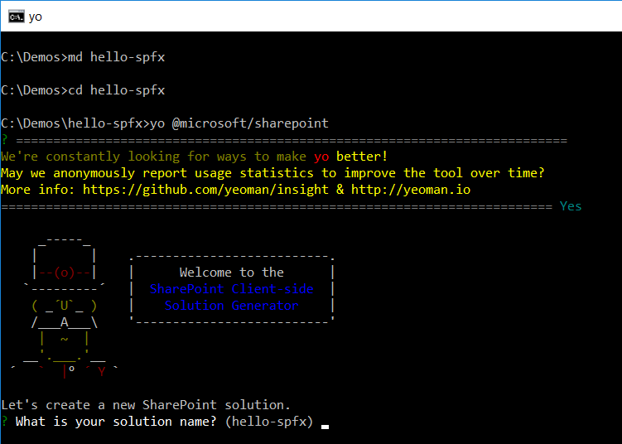
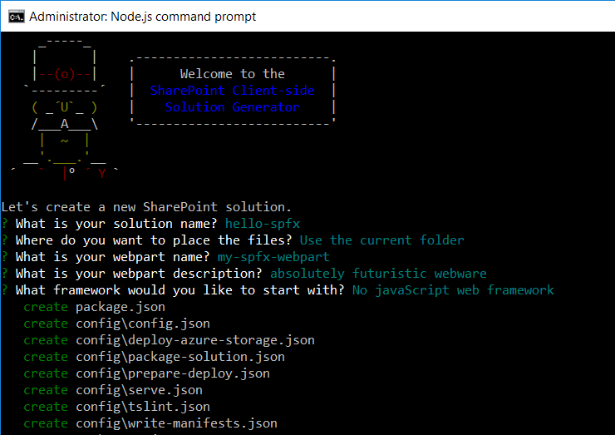
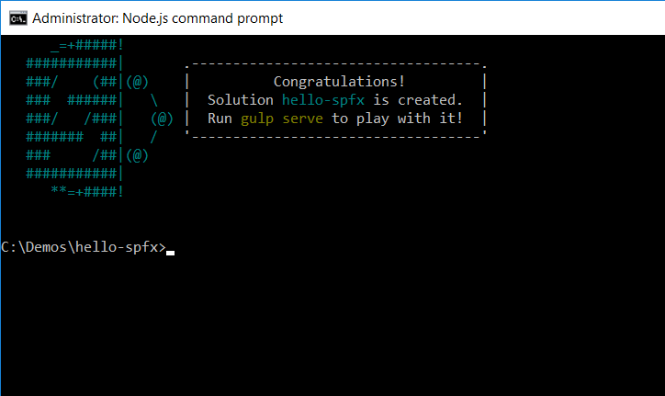
Using the SPFx Yeoman Template
SPFx projects created with Yeoman template
yo @microsoft/sharepoint
Takes 8-10 minutes to complete
Create a directory with over 200MB of source files

Slide 12
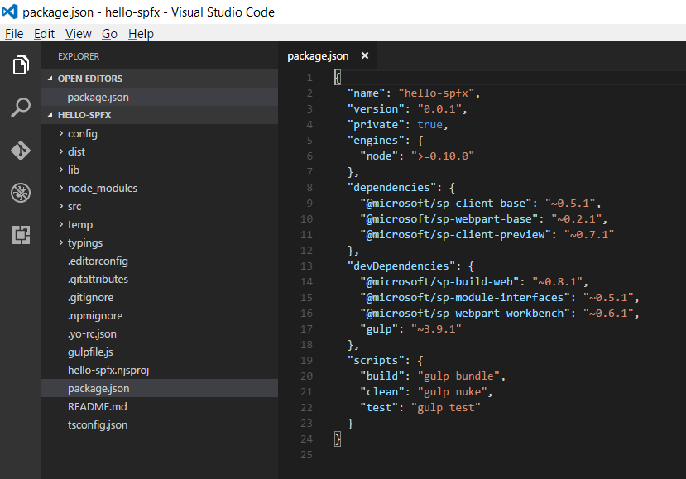
Package.json

Slide 13
Gulp as a Task Runner
Gulp serves as a Task Runner
Compiles TypeScript files to JavaScript
Compiles SASS files to CSS
Bundles and minifies JavaScript and CSS files
Create a self-signed certificate
gulp trust-dev-cert
Start up the project for testing & debugging
gulp serve

Slide 14
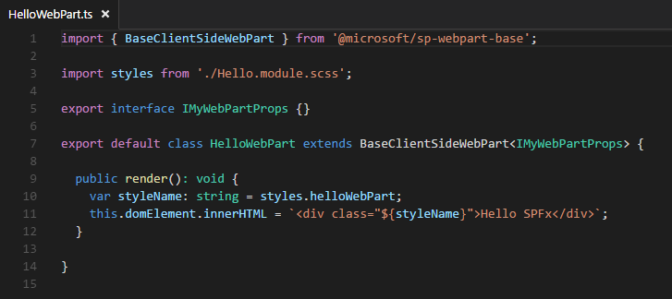
Developing a SPFx Web Part?
Create class that extends BaseClientSideWebPart
Override render() for minimal “hello world” functionality
Base class provides access to page context

Slide 15
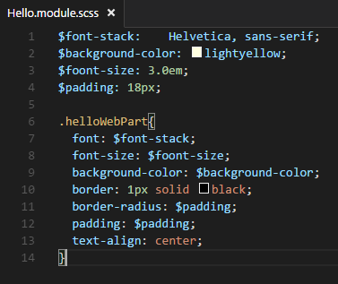
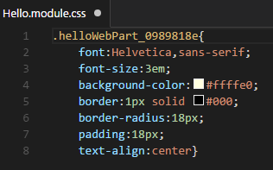
Working with SASS and .SCSS Files
Sass: Syntactically Awesome Style Sheets
Compiles .scss files into .css files
Allows build process to use variables and nesting
SASS

Slide 16
Hello World with SPFx

Slide 17
Adding a JavaScript Library (D3.js)
Adding package for D3.js library
npm install d3 –save
Add typings file to Intellisence and type checking
npm install @types/d3 --save-dev

Slide 18
Using D3 with SPFx

Slide 19
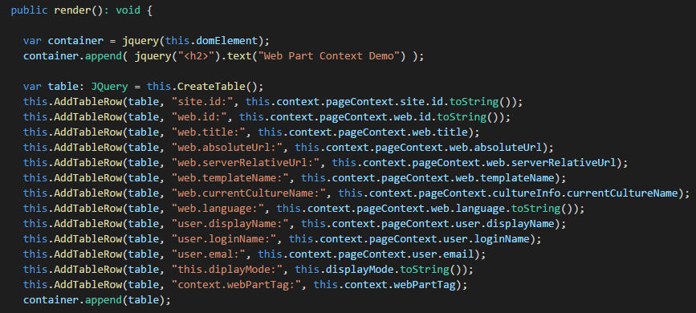
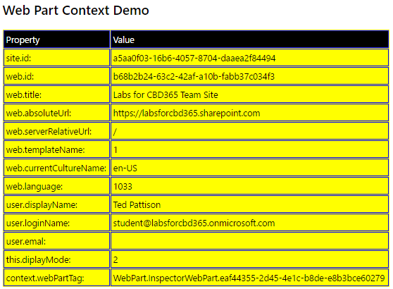
Web Part Context

Slide 20
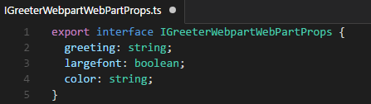
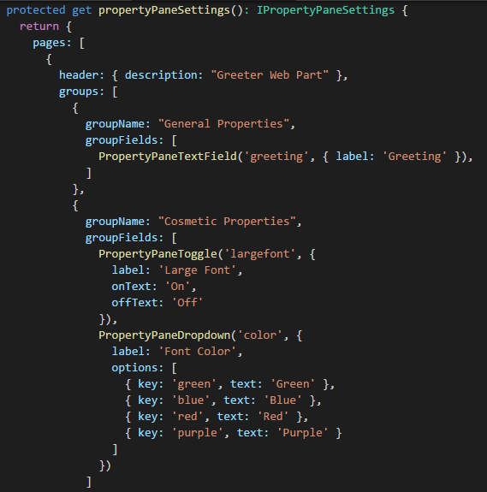
Web Part Properties
Define interface with properties
Add interface to web part class definition
Override panelPropertySettings()

Slide 21
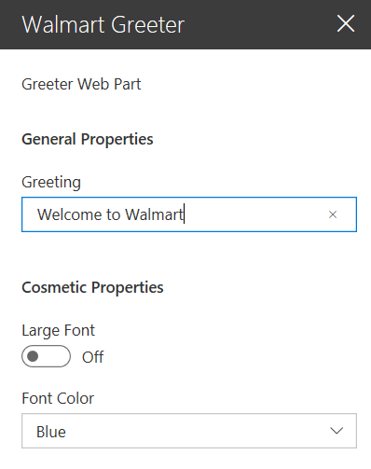
Property Panel Settings

Slide 22
Web Part Properties

Slide 23
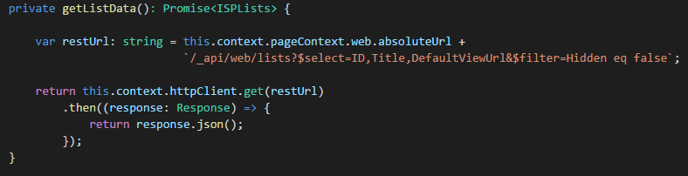
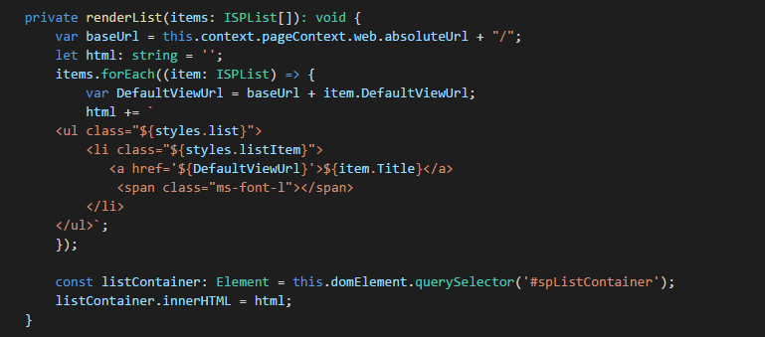
Calling the SharePoint REST API

Slide 24
Calling the SharePoint REST API

Slide 25
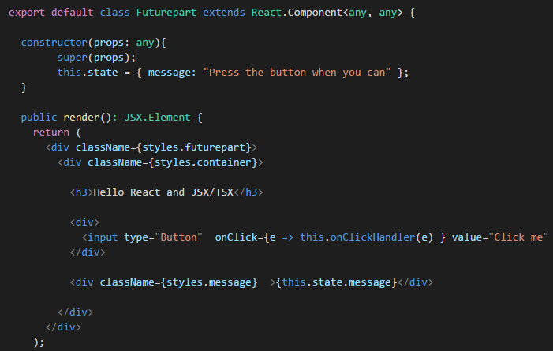
React and JSX

Slide 26
Creating Web Parts with React.js

Slide 27
Agenda
Overview the SharePoint Framework (SPFx)
Setting up an SPFx Development Environment
Creating Projects using the SPFx Templates
Deploying SPFx Projects using an Azure CDN

Slide 28
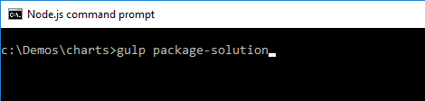
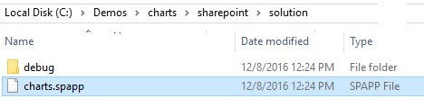
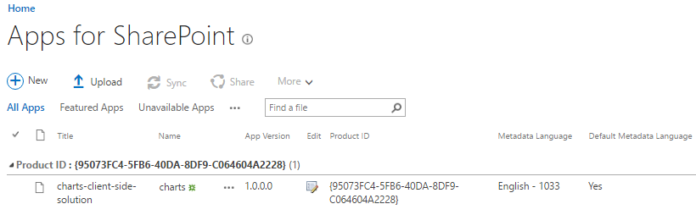
Building a Deployment Package

Slide 29
Deploying to Azure
Gulp commands to deploy to CDN
gulp --ship
gulp deploy-azure-storage
gulp bundle --ship
gulp package-solution --ship

Slide 30
Summary
Overview the SharePoint Framework (SPFx)
Setting up an SPFx Development Environment
Creating Projects using the SPFx Templates
Deploying SPFx Projects using an Azure CDN

Slide 31
